Slide 1
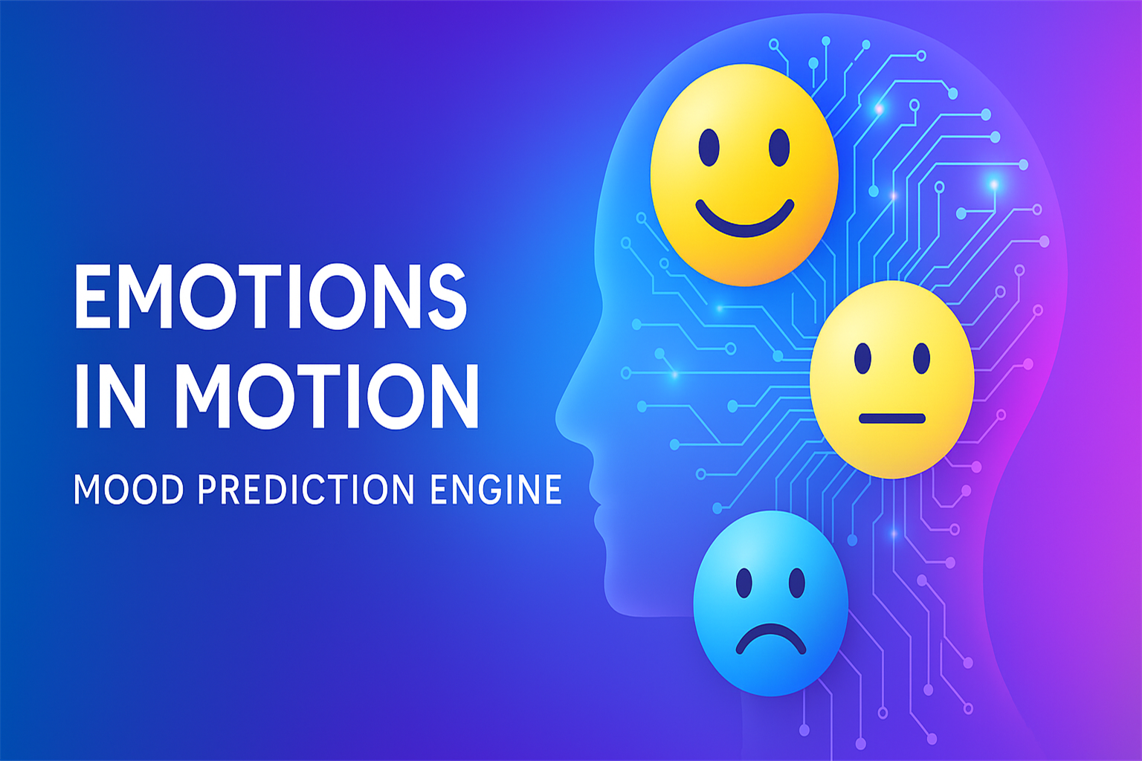


Prince Raj
August 2025

Slide 2

Table of Contents
The Story Begins: Why This Project Matters
What This Project Aims to Do
The Dataset – Fit-Life Simulation
Project Pipeline
SMOTE Handling
Feature Engineering
Model 1 – Random Forest
Model 2 - XGBoost
Model 3 – Deep Neural Network
Model Comparison & Summary
Final Takeaways
Future Vision
GitHub & Contact
Thank You

Slide 3

The Story Begins: Why This Project Matters
“We interact with technology daily. But what if tech could interact with our emotions?”
Every day, we go through different moods – joy, stress, fatigue, excitement. But what if our digital world could sense those changes?
I imagined a world where your smart device understands how you feel — and nudges you toward better habits.
That’s how this project was born: To explore if machines can learn to understand human mood through daily behavior.

Slide 4

What This Project Aims to Do
I built a machine learning system that classifies human mood into Bad, Neutral, or Good using activity patterns and emotional signals like stress, energy, and intensity.
The vision: A future where mood-aware AI supports wellness, mental health, and productivity. Embed mood intelligence into smart devices, apps, wearables.

Slide 5
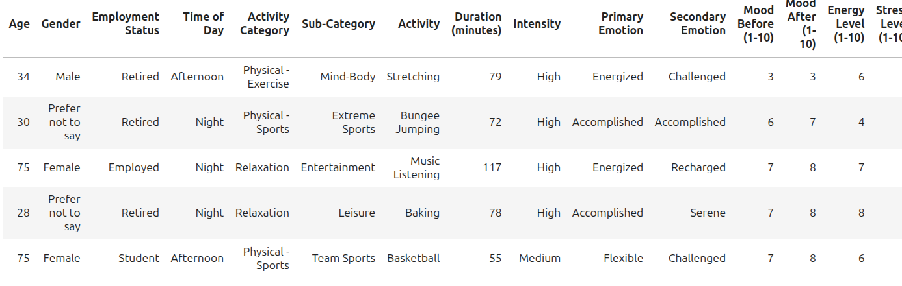
The Dataset – Fit-Life Simulation
I worked with a synthetic behavioral dataset of over 100,000 rows capturing how people live, move, and feel throughout their day.
Key features included:
Age, Gender, Employment
Type of Activity, Duration, Intensity
Mood Before / After, Energy, Stress
Mood Scale (1–10 ) into 3 classes:
Bad (1–3) Neutral (4–6), Good (7–10)

Slide 6
Project Pipeline
Let me show you the complete pipeline — from raw data to trained model.
Raw FitLife CSV
Missing Value Handling
Mood Class Conversion
Drop Leakage Columns
StandardScaler
SMOTE Oversampling
Train-Test Split
One-Hot Encoding
Model Training
Evaluation
Model Comparison
Final Decision

Slide 7
SMOTE Handling
The original dataset had very skewed mood distribution — Neutral was dominant. So, I used SMOTE (Synthetic Minority Over-sampling Technique) to balance the training data.
Class Distribution Before SMOTE
Class Distribution After SMOTE

Slide 8
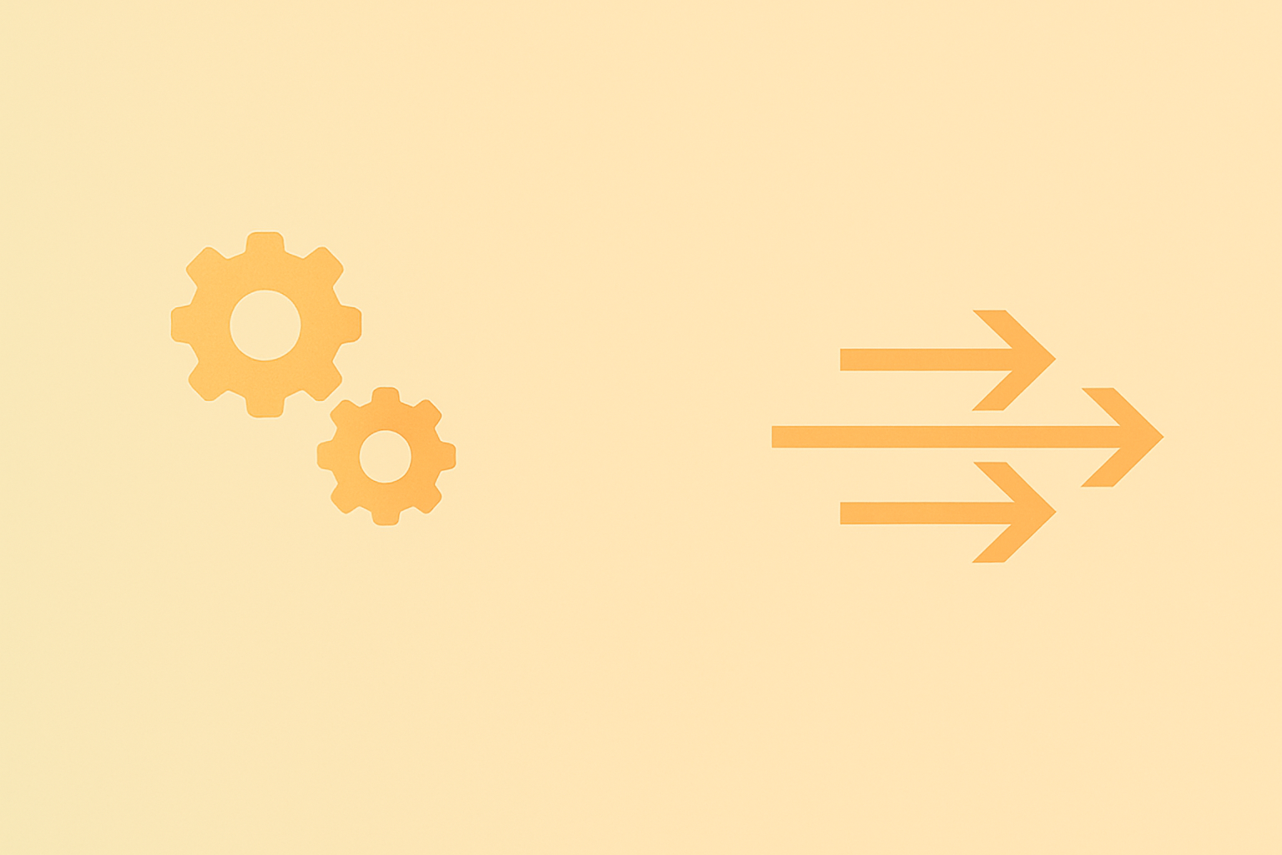
Feature Engineering
I dropped unnecessary columns like Date and Mood After to avoid leakage.
Then applied One-Hot Encoding → ended with 317 features.
For numeric fields like Age, Mood Before, Stress, I applied Standard Scaler - essential for deep learning models to converge properly.

Slide 9
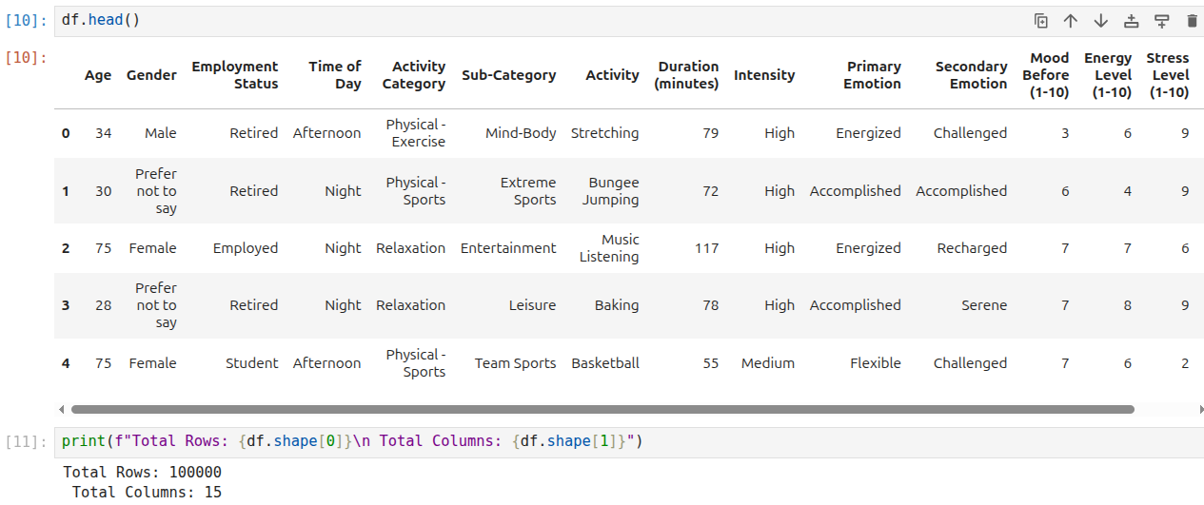

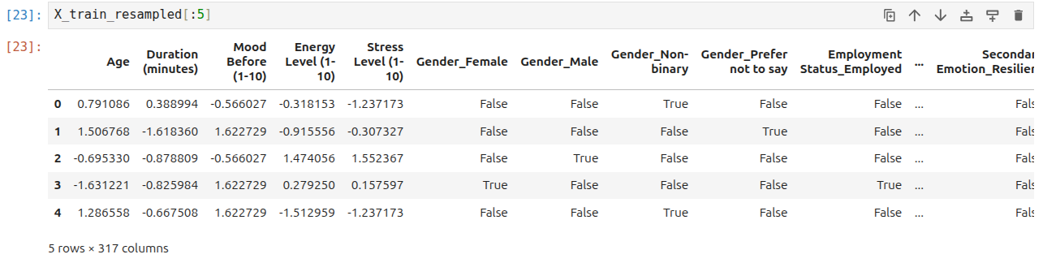

Feature Engineering
Before encoding
After One-hot encoding /
StandardScaler

Slide 10
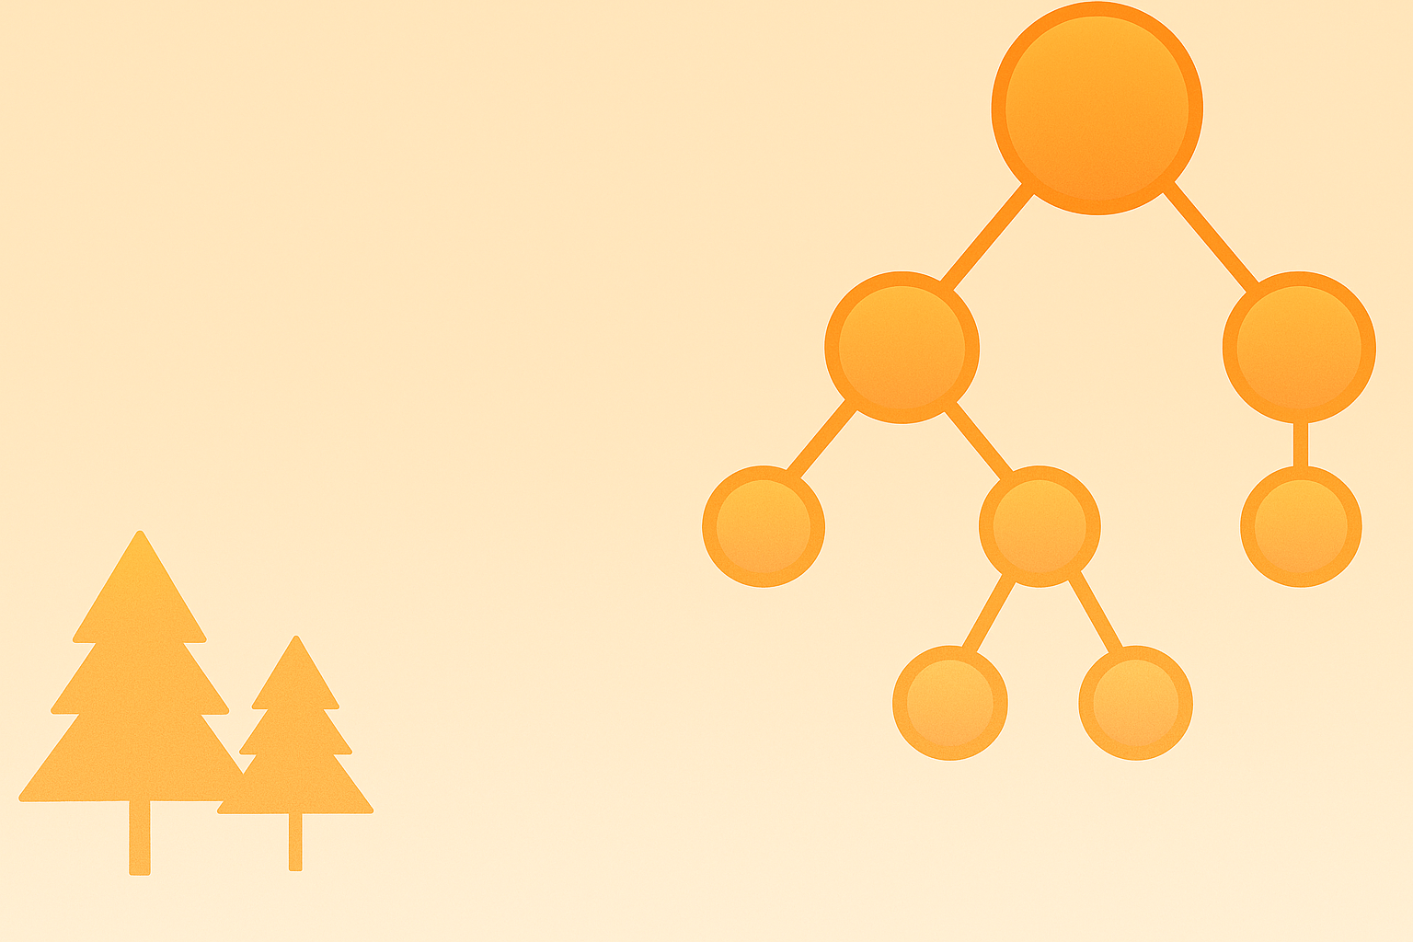
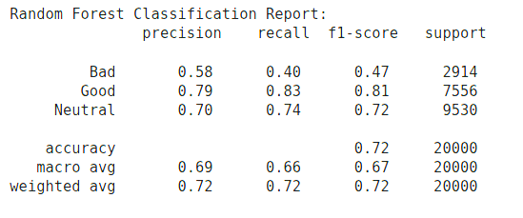
Model 1 – Random Forest
First, I trained a Random Forest to get quick, interpretable results.
Accuracy: 72.4%
Best at predicting Neutral / Good mood
Classification Report

Slide 11
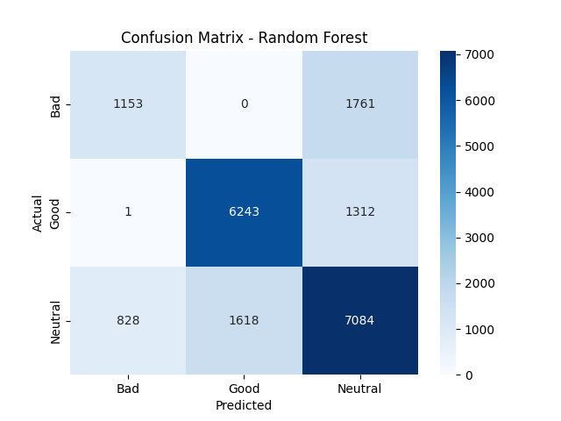
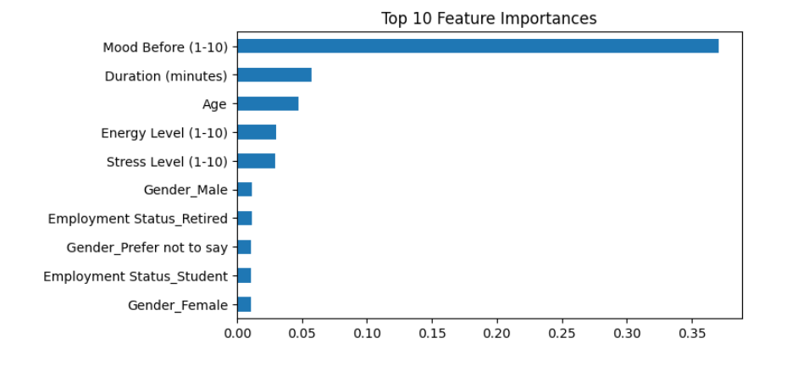
Model 1 – Random Forest
Confusion Matrix – RF
Top 10 Features – RF

Slide 12


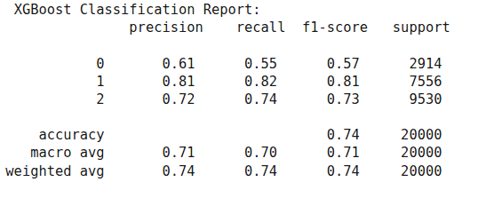
Model 2 – XGBoost
Then I trained XGBoost — A smarter learner with better interaction capture.
Accuracy: 74.1%
Best at predicting Bad mood
Classification Report

Slide 13
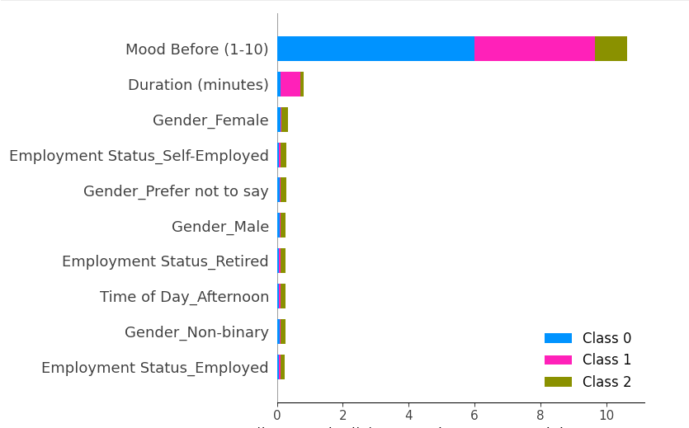
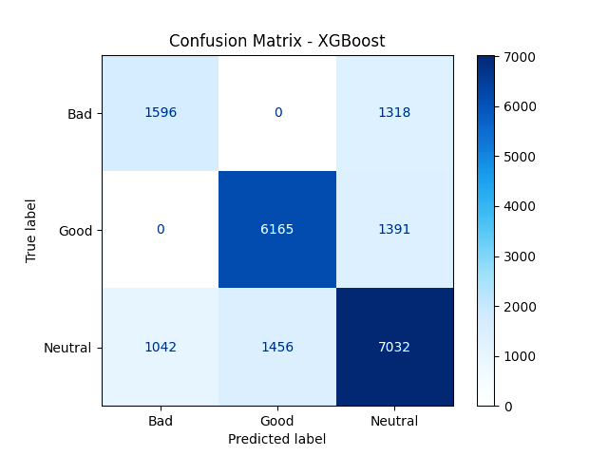
Model 2 – XGBoost
Feature Contributions (Top 10 – SHAP summary)
Confusion Matrix
SHAP reveals 'Mood Before', 'Duration', and 'Gender' as key signals.
XGBoost showed slightly better sensitivity to 'Bad' mood than Random Forest.

Slide 14
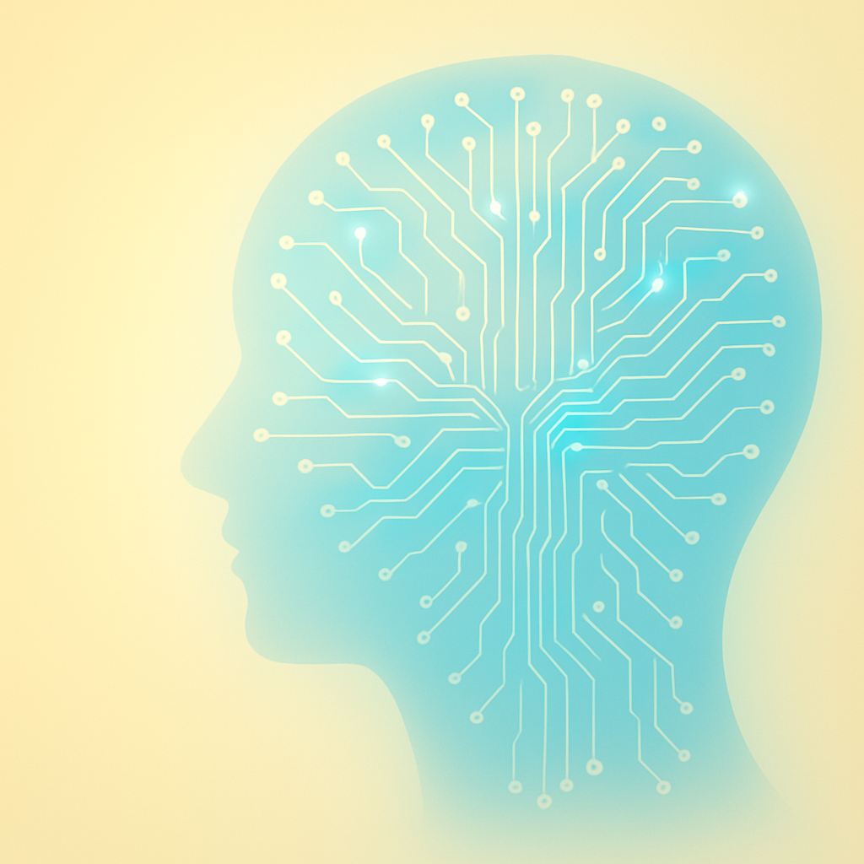
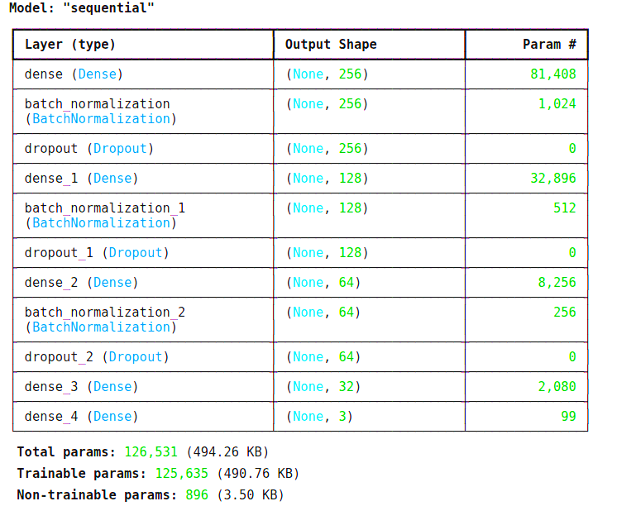
Model 3 – Deep Neural Network
Finally, I trained a DNN using batch normalization, dropout, and early stopping.
Accuracy: 74.2%
More consistent across all mood classes
DNN with 126K trainable parameters across 5 dense layers and regularization components.

Slide 15
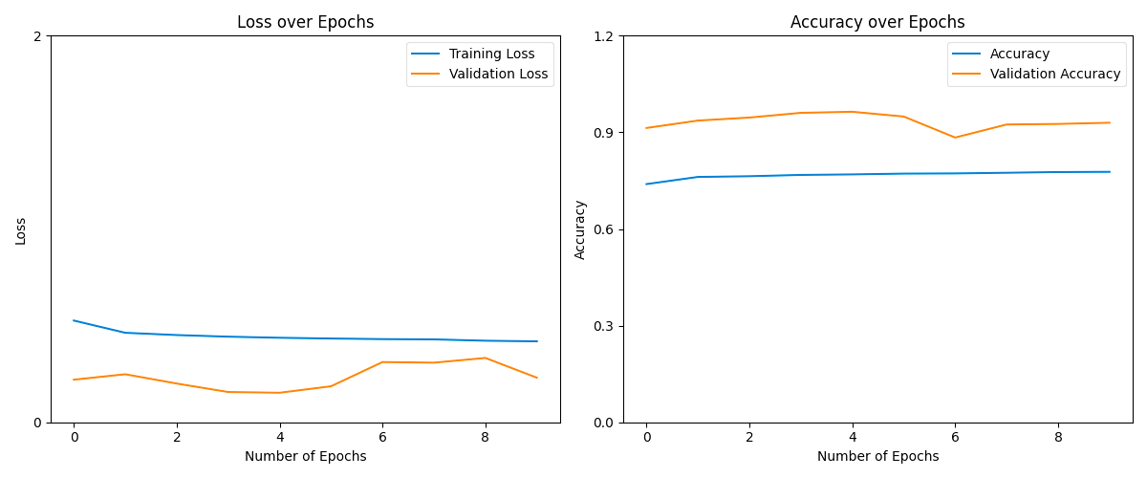
Model 3 – Deep Neural Network
Model showed stable training with minor variance in validation performance across epochs.

Slide 16
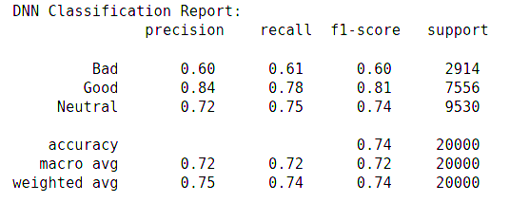
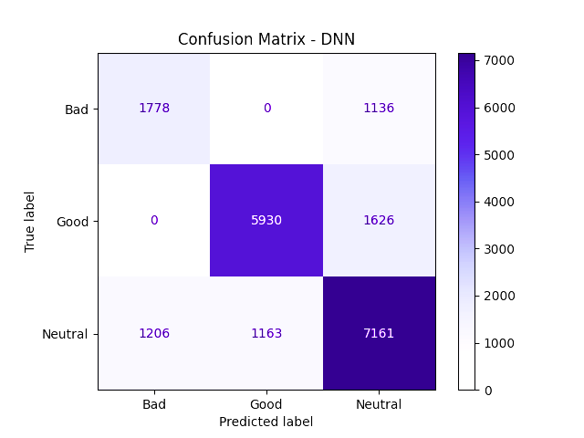
Model 3 – Deep Neural Network
Classification Report
Confusion Matrix

Slide 17

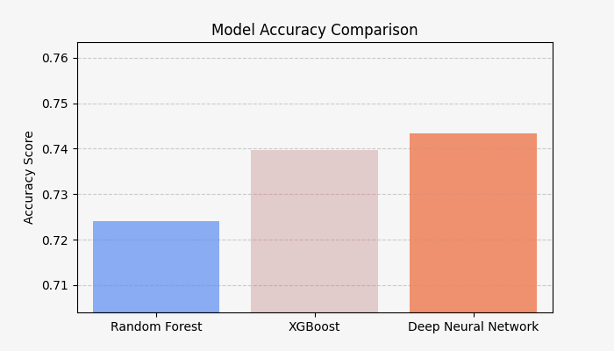
Model Comparison & Summary
All three models performed well — with DNN slightly ahead in overall accuracy.
Random Forest: ~72.4%
XGBoost: ~74%
DNN: ~74.2%

Slide 18

Final Takeaways
Mood is predictable — using activity + emotional signals
DNN gave best generalization
SHAP added transparency and trust
SMOTE made results more fair across mood classes

Slide 19

Future Vision
In future versions, this engine could:
Predict energy + stress along with mood
Be embedded into wearables or wellness apps
Adapt to real-time mood shifts using LSTM
Imagine your smartwatch saying:
“Hey, you’ve been low all morning. Want to stretch or take a walk?”

Slide 20

GitHub & Contact
Project Notebook, Graphs, and Code:
🔗 GitHub​
Connect with me:
🔗 LinkedIn​

Slide 21
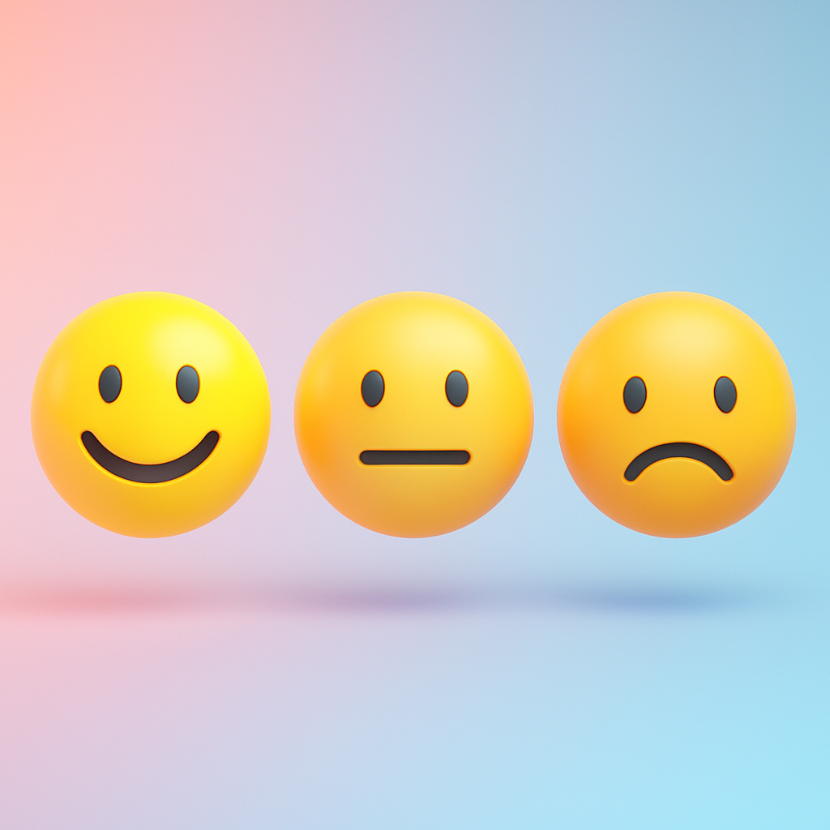
Thank You
Let's build AI that not only understands emotions — but truly cares.

